Slide 1
Power Bi
i. Introduction to DAX
ii. Difference between columns and measures and implementations of the same
iii. Calculated Column –Extracting the characters
iv. Sales 10% up up and down analysis (Static what if analysis)
v. Card visual and its properties
vi. Profit %Age calculation and showing data in a percentage form
vii. Gauge chart and its properties
viii. Year, quarter, month and day extract functions from dates

Slide 2
Introduction to DAX
Data Analysis Expressions (DAX) is a syntax language that comprises formulae and expressions that are used in data manipulation
Derived fields/calculated fields
Tables
Columns
Measures

Slide 3
Tables
Sample Table = {1} -Row
Sample Table = {(1)} -Column
Sample Table = {(1,2,3,4)} 1 row 4 columns
Sample Table = {(1,2),(3,4)} 2 row 2 columns
Multi clm table = SUMMARIZE(Orders,Orders[City],Orders[Category],Orders[Sales])

Slide 4
Difference between columns and measures and implementations of the same
Non Agg:
Cust Name: custfname concat with custlname
Year of Birth: extract year from dob
Agg:
No of Customers: count of custid
Columns:
Non Aggregated calculations
Is calculated at the data level of power bi
Measures:
Aggregated calculations
Is calculated at the visual level of power bi

Slide 5
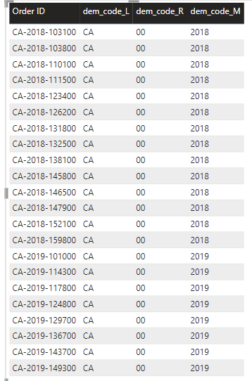
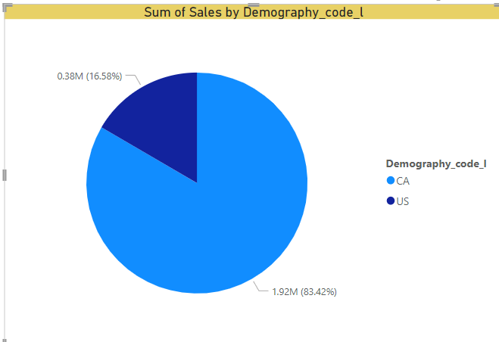
Calculated Column
Demograpy Code_L = LEFT(Orders[Order ID],2)
Demograpy Code_R = RIGHT(Orders[Order ID],2)
Demograpy Code_M = MID(Orders[Order ID],4,4)
joining two columns = CONCATENATE(Orders[Demography_code_l],CONCATENATE("-",Orders[City]))

Slide 6
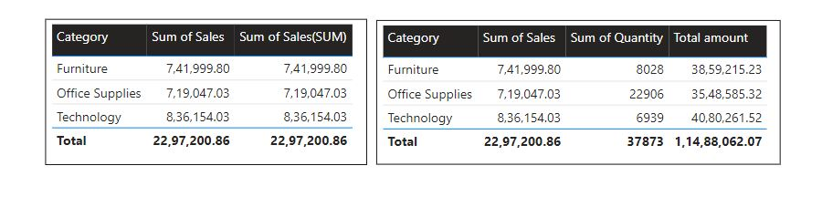
Calculated Measure
SUM | SUMX
Returns a scalar value | Returns a scalar value
Works on column level | Works on row level
Expression not allowed | Expression are allowed
Sum of Sales(SUM) = sum(Orders[Sales])
Total amount = sumx(orders, orders[quantity]*Orders[Sales])

Slide 7
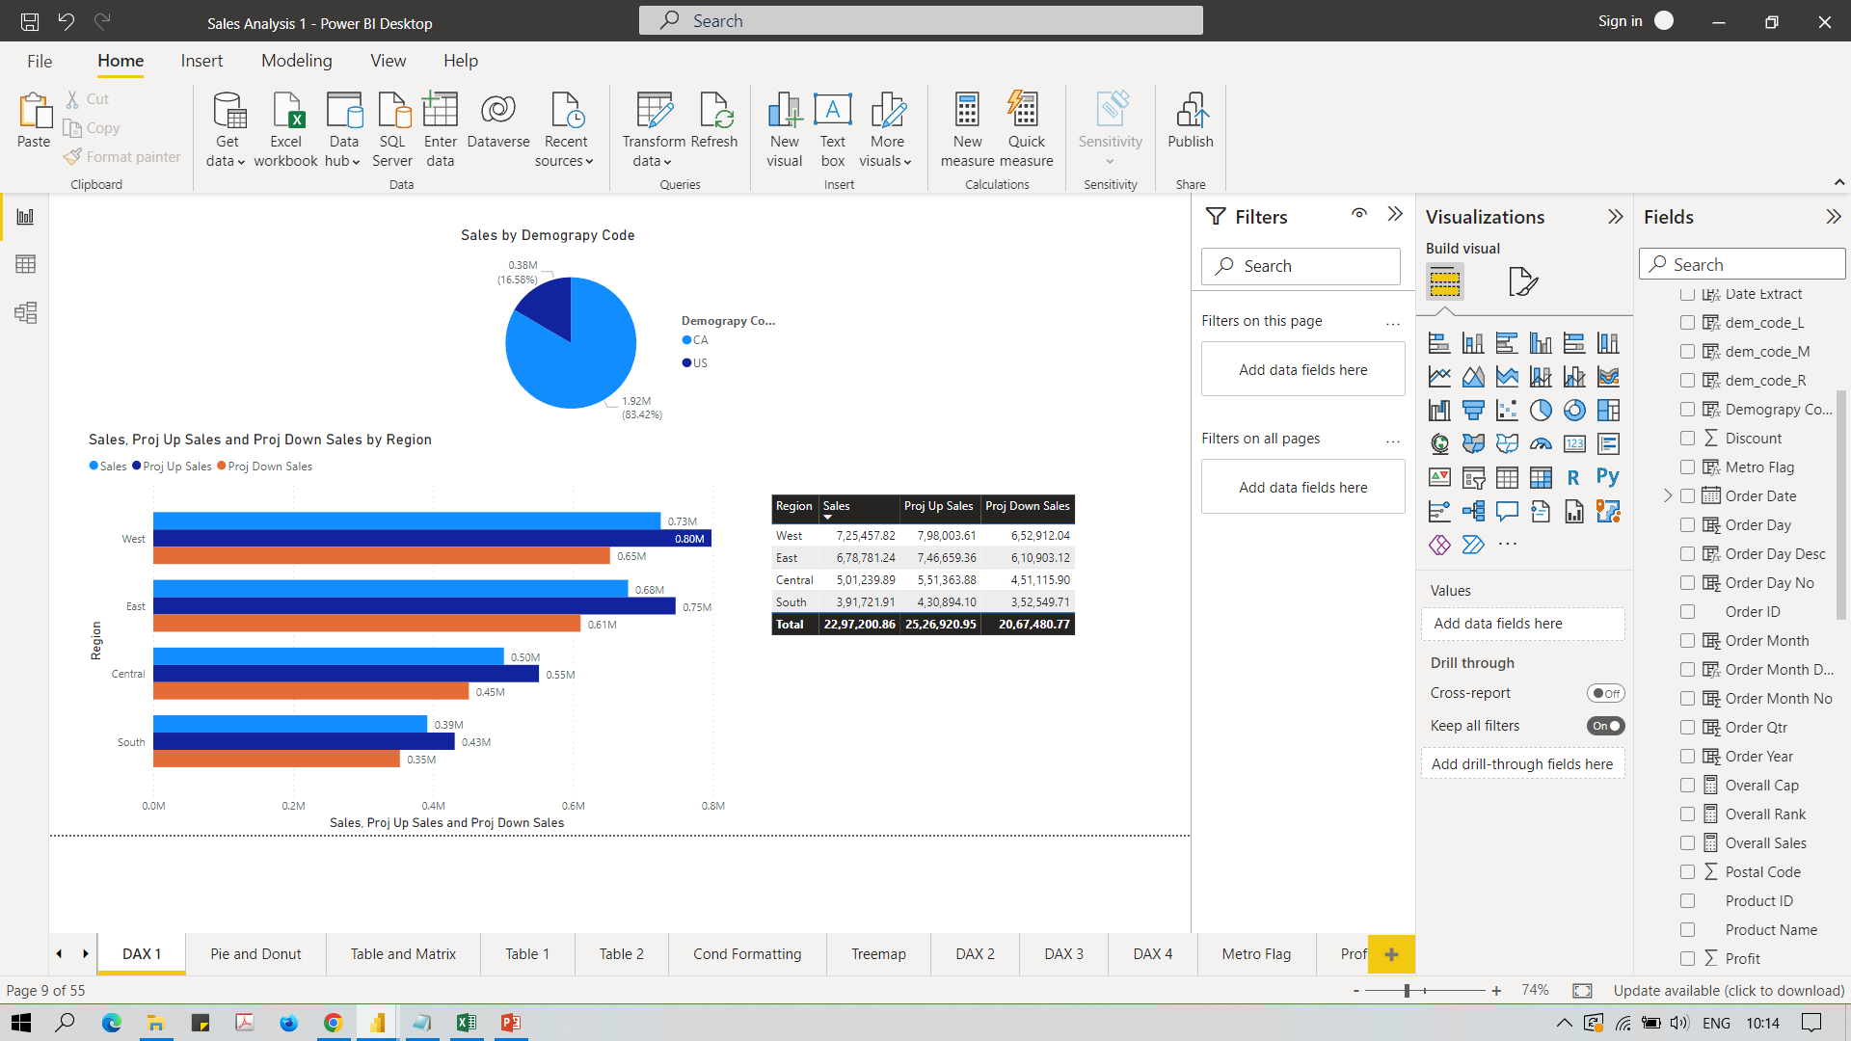
Calculated Measure
What if analysis:
what if sales is 10% more
Proj Up Sales = SUM(Orders[Sales]) * 1.1
sum(orders[sales])+(sum(orders[sales])*10)/100)
what if sales is 10% less
Proj Down Sales = SUM(Orders[Sales]) * 0.9
sum(orders[sales])-(sum(orders[sales])*10)/100)

Slide 8
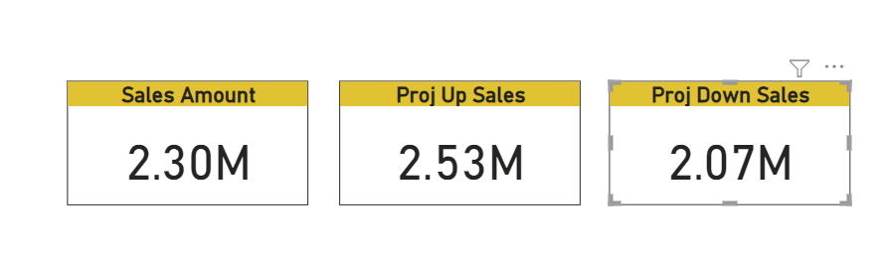
Card visual and its properties

Slide 9
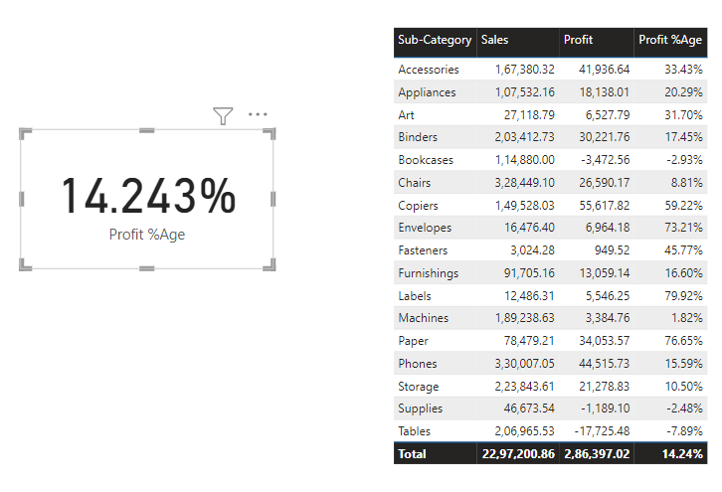
Profit %Age calculation and showing data in a percentage form
Profit %Age:
(profit/cp) * 100
Profit %Age = SUM(Orders[Profit]) / (SUM(Orders[Sales]) - SUM(Orders[Profit]))

Slide 10
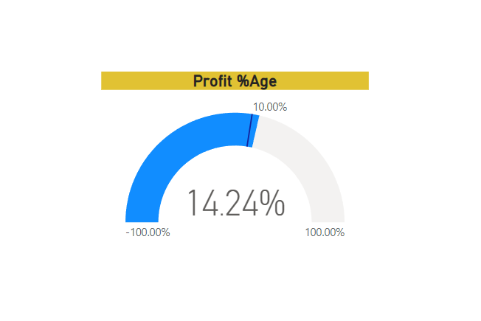
Gauge chart and its properties

Slide 11
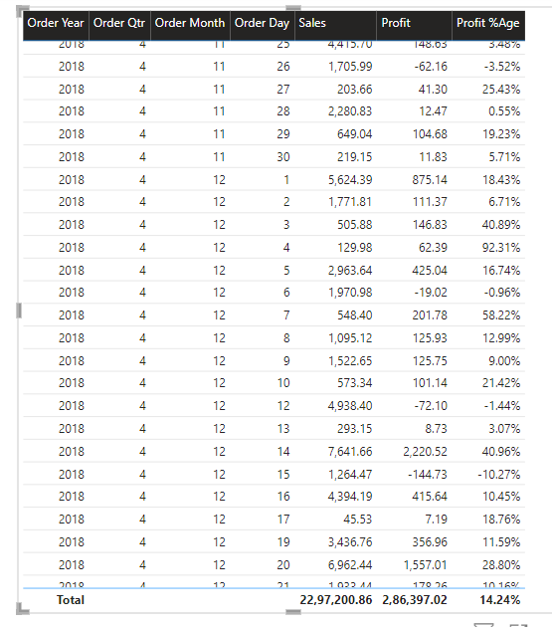
Year, quarter, month and day extract functions from dates
Order Year = YEAR(Orders[Order Date])
Order Qtr = QUARTER(Orders[Order Date])
Order Month = MONTH(Orders[Order Date])
Order Day = DAY(Orders[Order Date])

